Slide 1
TEST 2

Slide 2
comedy / ˈkɒmədi, ˈkɒmɪdi / noun a play, film, or television programme that is intended to make people laugh :
- a highly successful TV comedy

Slide 3
plenty / ˈplenti / pronoun a large quantity that is enough or more than enough plenty of
- Make sure she gets plenty of fresh air.
- No need to hurry – you’ve got plenty of time.

Slide 4
caterer / ˈkeɪtərə / noun a person or company that provides and serves food and drinks at a party, meeting etc

Slide 5
vegetarian / ˌvedʒəˈteəriən, ˌvedʒɪˈteəriən / noun someone who does not eat meat or fish
- Our youngest daughter is a vegetarian.
- dishes suitable for vegetarians vegetarian adjective :
- a vegetarian restaurant

Slide 6
steak / steɪk / noun good quality beef, or a large thick piece of any good quality red meat

Slide 7
film / fɪlm / noun the thin plastic used in a camera for taking photographs or recording moving pictures :
- I shot five rolls of film on vacation.

Slide 8
roll / rəʊl / noun a piece of paper, camera film, money etc that has been rolled into the shape of a tube roll of
- I used up three rolls of film on holiday.

Slide 9
digital / ˈdɪdʒətl, ˈdɪdʒɪtl / adjective using a system in which information is recorded or sent out electronically in the form of numbers, usually ones and zeros :
- digital TV
- a digital camera

Slide 10
ˈhouse-ˌwarming noun a party that you give to celebrate moving into a new house :
- Are you coming to Jo’s house-warming on Friday?
- a house-warming party

Slide 11
entitle / ɪnˈtaɪtl / verb to give someone the official right to do or have something be entitled to (do) something
- Full-time employees are entitled to receive health insurance. entitle somebody to something
- Membership entitles you to the monthly journal.

Slide 12
cartridge / ˈkɑːtrɪdʒ / noun a small container or piece of equipment that you put inside something to make it work :
- computer game cartridges an ink cartridge for a printer

Slide 13
marker / ˈmɑːkə / noun
( also marker pen British English ) a large pen with a thick point made of felt, used for marking or drawing things

Slide 14
coupon / ˈkuːpɒn / noun a small piece of printed paper that gives you the right to pay less for something or get something free :
- The coupon entitles you to ten cents off your next purchase.

Slide 15
valid / ˈvæləd, ˈvælɪd / adjective a valid ticket, document, or agreement is legally or officially acceptable OPP invalid :
- a valid credit card
- Your return ticket is valid for three months.

Slide 16
orchestra section/seats American English the area of seats in a theatre close to and on the same level as the stage

Slide 17
lecture verb to talk angrily or seriously to someone in order to criticize or warn them, in a way that they think is unfair or unnecessary :
- I wish you’d stop lecturing me! lecture somebody about/on something
- He began to lecture us about making too much noise.

Slide 18
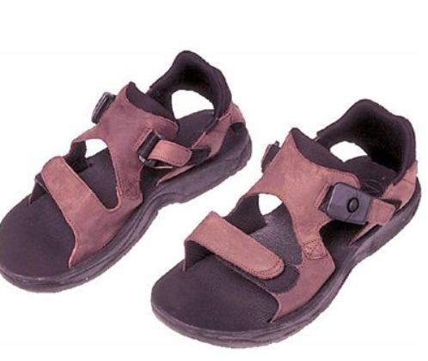
sandal / ˈsændl / noun a light shoe that is fastened onto your foot by bands of leather or cloth, and is worn in warm weather :
- a pair of sandals

Slide 19
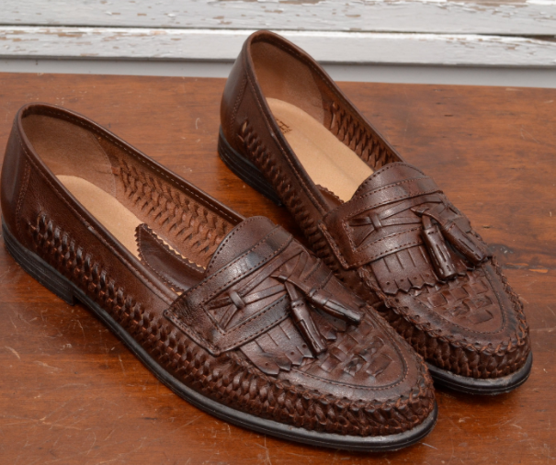
leather loafers a flat leather shoe that does not need to be fastened onto your foot

Slide 20
catalogue ( also catalog American English ) / ˈkætəlɒɡ / noun a complete list of things that you can look at, buy, or use, for example in a library or at an art show :
- a mail order catalog
- an online catalogue

Slide 21
ˌworn ˈout adjective too old or damaged to be used :
- a pair of old worn-out walking boots

Slide 22
daybook = datebook noun American English a small book in which you write things you must do, addresses, telephone numbers etc SYN diary

Slide 23
Kowalski
Miami
Chicago
Tang
Mary
Miller
BrownWalma
Walmax
Park

Slide 24
THANK YOU

